Slide 1
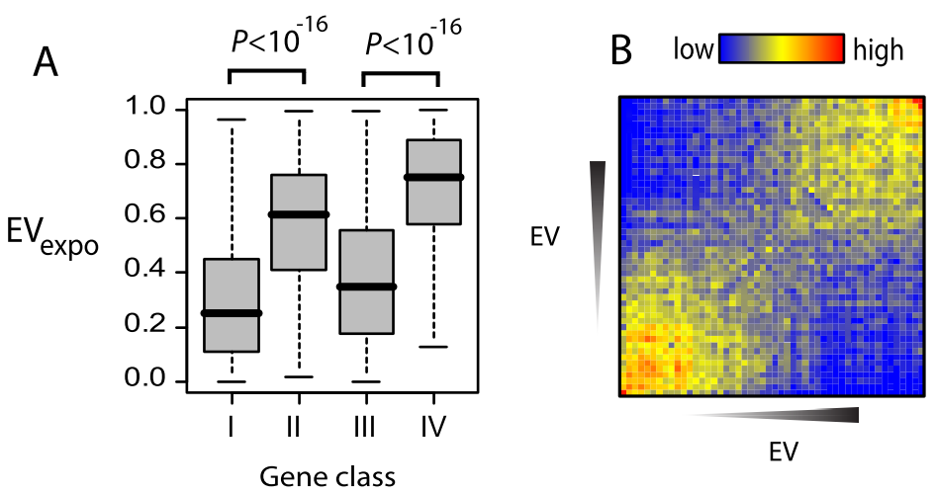
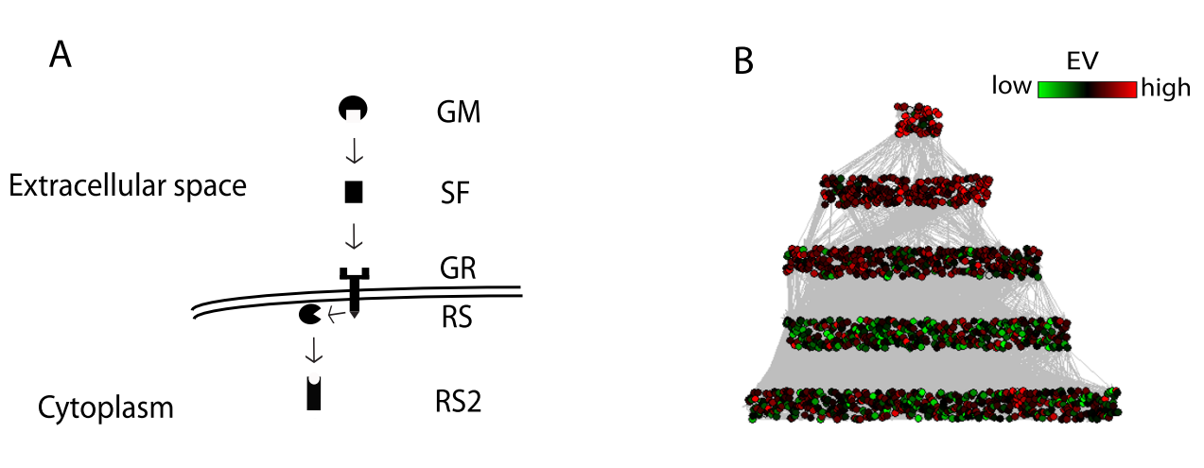
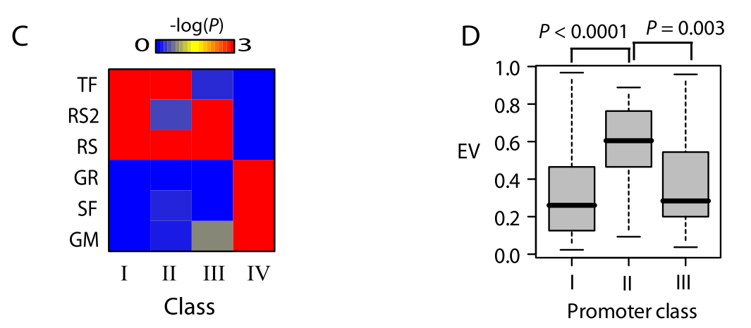
南京中医药大学医学院第一届青年科学家论坛
PO XXXX-XXXX
Title: an accurate and semi-automatic annotation pipeline with signaling network hierarchy
&&&&&&¹, &&&&&&&&¹*
Department of ********, School of medicine, Nanjing University of Chinese Medicine
Introduction
Materials and Methods
In this study we show a new genome annotation pipeline applying for fungal genome, especially for trichoderma. In the past decade, numerous important Trichoderma genomes have ben sequenced, which pla. After assembly a novel genome, gene calling is often the next step analyzing the features of the strain. Accurate predicted gene models is crucial to the success of all subsequent analysis and experiments.
In this study we show a new genome annotation pipeline applying for fungal genome, especially for trichoderma. In the past decade, numerous important Trichoderma genomes have ben sequenced, which pla. After assembly a novel genome, gene calling is often the next step analyzing the features of the strain.
Figure 1
Table 2 The gene calling results trichoCODE were higher than both of Maker2 and ab initio prediction tools(Augustus, GeneMark and SNAP) with or without transcript data.
The annotation of eukaryotic genome is a challenging task, many existed tools or pipelines use different algorithms and evidences finish this work. As the cost of RNA-Seq sequencing getting lower and the high accuracy of mapping RNA-Seq reads to the complex genomes promised, more and more tools leveraged the RNA-Seq reads into gene finding.
Reference Organism | Performance Category |  | Ab Initio Predictions |  |  |  | Pipeline annotations
 |  |  | Augustus | GeneMark | SNAP |  | trichCODE I | trichCODE II | Maker2
T. atrivoride | Nucleotide Accuracy |  | 94.03% | 97.18% | 96.07% |  | 96.41% | 95.19% | 93.52%
 | Exon Accuracy |  | 60.87% | 63.26% | 54.82% |  | 63.86% | 65.27% | 64.08%
 | Gene Accuracy |  | 43.59% | 41.76% | 36.86% |  | 46.29% | 41.37% | 46.27%
T. virens | Nucleotide Accuracy |  | 95.09% | 98.59% | 97.38% |  | 97.34% | 97.88% | 93.98%
 | Exon Accuracy |  | 58.45% | 61.33% | 47.45% |  | 60.81% | 62.13% | 58.98%
 | Gene Accuracy |  | 41.01% | 40.63% | 30.69% |  | 43.58% | 44.35% | 41.54%
T. asperullum | Nucleotide Accuracy |  | 98.58% | 98.79% | 98.56% |  | 98.34% | 98.99% | 98.00%
 | Exon Accuracy |  | 70.19% | 67.48% | 60.78% |  | 67.15% | 76.33% | 63.95%
 | Gene Accuracy |  | 52.01% | 47.53% | 42.55% |  | 50.36% | 61.58% | 37.43%
1
Figure 2 Homology proteins
Orthologs among Trichoderma reesei, Trichoderma virens and Trichoderma atroviride were identified with OrthoMCL. The protein sequences of all the three strains were compared all-against-all using BLASTP with E value 1e-05 and a cutoff value of 70. Then all homologous proteins were grouped into orthologous genes by the cluster tool MCL with an inflation value of 1.5.
Figure 3 607 new gene models were predicted by trichoCODE on T. reesei which has 173 show consistent to T. reesei C-30.
Table 1 Compared the results with the latest release of annotated models from JGI, using Eval on T. virens, T. atroviride and T. asperellum.
 | T. virens |  |  |  |  | T. atrorivide |  |  |  |  | T. asperellum
 | JGI | trichCODE I | trichCODE II | Maker2 |  | JGI | trichCODE I | trichCODE II | Maker2 |  | JGI | trichCODE I | trichCODE II | Maker2
Genes
Total Num | 12,427 | 10,926 | 11,483 | 8,236 |  | 11,863 | 10,552 | 10,606 | 8,239 |  | 12,586 | 10,020 | 10,518 | 8,948
Ave Length | 1,710.67 | 1,569.33 | 1,575.53 | 1,787.53 |  | 1,799.60 | 1,565.93 | 1,575.85 | 1,848.53 |  | 1,651.30 | 1,581.33 | 2,222.14 | 2,282.28
Ave Coding Length | 1,412.18 | 1,432.90 | 1,433.71 | 1,533.06 |  | 1,366.44 | 1,428.31 | 1,434.54 | 1,523.95 |  | 1,326.08 | 1,436.64 | 1,524.44 | 1,580.39
Exons
Total Num | 36,118 | 28,423 | 30,525 | 23,825 |  | 33,171 | 27,410 | 27,980 | 23,923 |  | 33,338 | 26,281 | 29,539 | 26,726
Ave Exons Per | 2.91 | 2.6 | 2.7 | 2.9 |  | 2.8 | 2.6 | 2.6 | 2.9 |  | 2.6 | 2.6 | 2.8 | 3
Intron
Total Num | 23,688 | 17,496 | 19,041 | 15,588 |  | 21,310 | 16,856 | 17,372 | 15,683 |  | 20,755 | 16,263 | 18,698 | 17,777
Total Length | 2,449,972 | 1,490,487 | 1,628,482 | 1,509,822 |  | 2,175,260 | 1,451,988 | 1,498,559 | 1,488,077 |  | 2,001,822 | 1,449,775 | 1,637,162 | 1,835,034
Ave Length | 103.43 | 85.19 | 85.53 | 96.86 |  | 102.08 | 86.14 | 86.26 | 94.88 |  | 96.45 | 89.15 | 87.56 | 103.23
KOG
Hit num | 6,091 | 5,732 | 5,893 | 4,877 |  | 5,709 | 5,512 | 5,537 | 4,847 |  | 5,624 | 5,376 | 5,911 | 4,960
Hit percent | 49.00% | 52.00% | 51.00% | 59.00% |  | 48.00% | 52.00% | 52.00% | 59.00% |  | 45.00% | 54.00% | 56.00% | 55.00%
Pfam
Hit num | 8,159 | 7,419 | 7,696 | 6,180 |  | 7,584 | 7,123 | 7,170 | 6,093 |  | 7,467 | 6,885 | 7,750 | 6,319
Hit percent | 65.66% | 67.90% | 67.02% | 75.04% |  | 63.93% | 67.50% | 67.60% | 73.95% |  | 59.33% | 68.71% | 73.68% | 70.62%
Conclusions
1
trichoCODE is a highly accurate, semi-automatic fungal gene predictor designed to work with assembled, aligned RNA-seq transcripts and prepared protein homologos. Our approach capitalises on the high quality of fungal, especially on Trichoderma strains by leveraging EVM to combine different evidences. Accuracy predictions are made by multi-run on corrected parameters made by supervisor.
Acknowledgement
This research was financially supported by the National Natural Science Foundation of China and National Key Basic Research Program of China
Corresponding E-mail: ****@&&&&

